Slide 1
Pharmaceutical Side Effect incidence in OECD countries Final Project Data Harvesting Sara & Mika

Slide 2

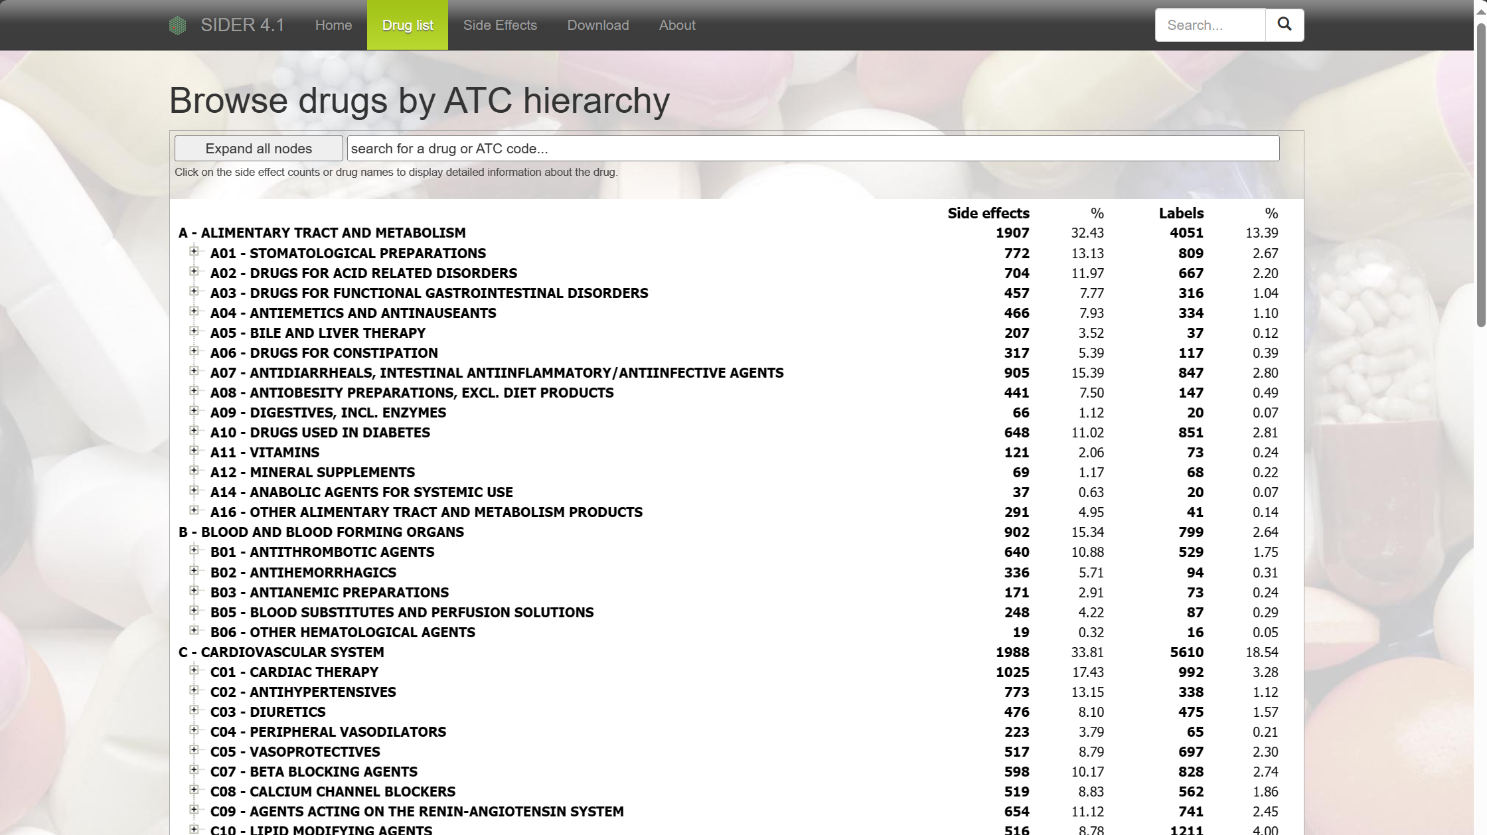
The Website - SIDER
Contains information on marketed medicines and their recorded adverse drug reactions. The information is extracted from public documents and package inserts. The available information include side effect frequency, drug and side effect classifications as well as links to further information, for example drug–target relations.

Slide 3
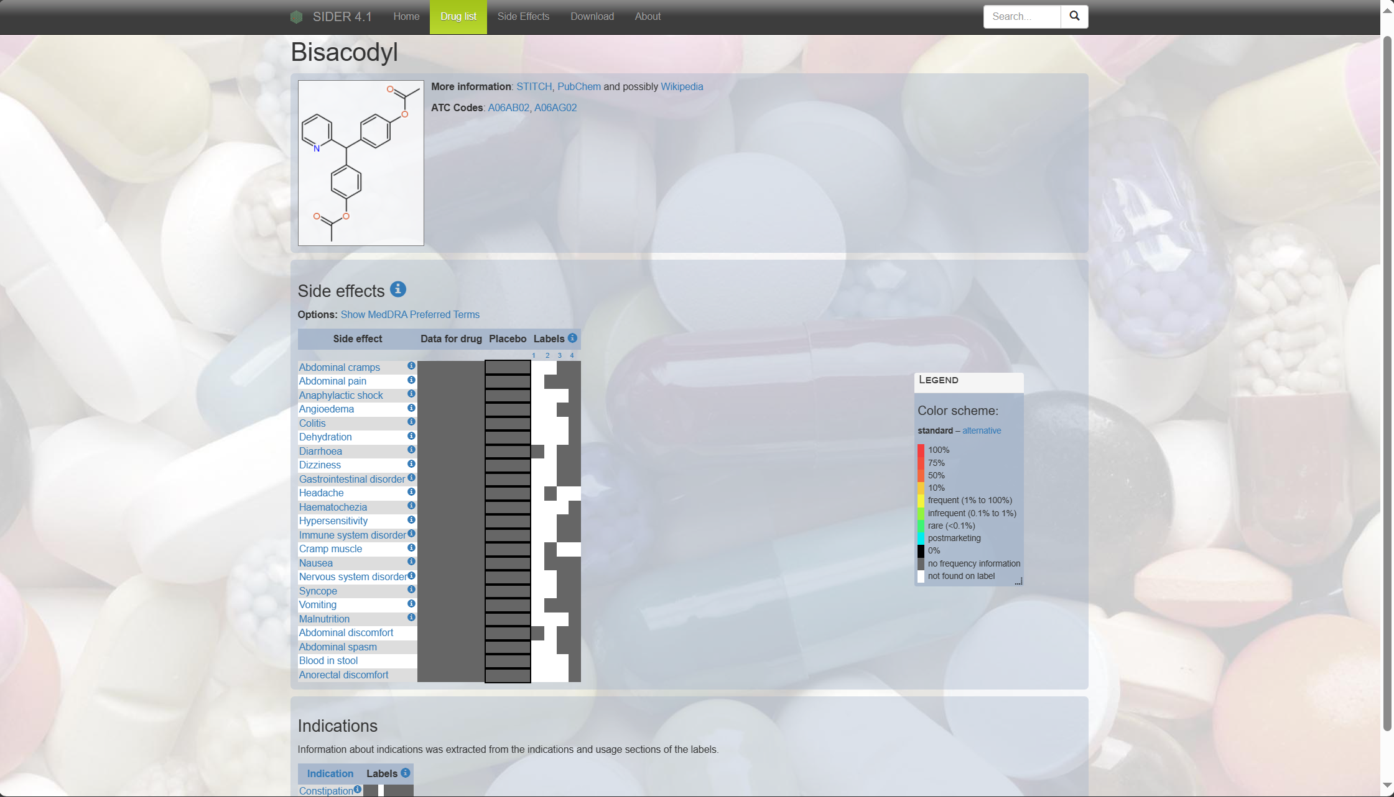
The Website - SIDER
ATC codes
Drug name
Side Effects
Indications

Slide 4

Navigating the site

Slide 5
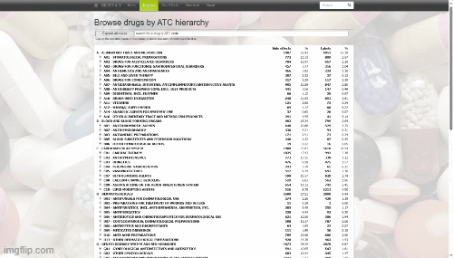

Navigating the site
We need to get from ‘Home’ to ‘target’ pages without having to manually extract each link…

Slide 6
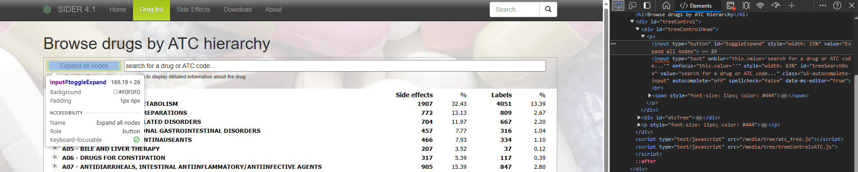
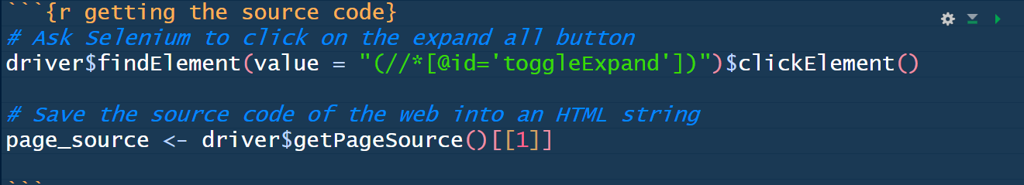
R Selenium
Finding the XPath expression for the button, we are able to locate it in `RSelenium` and click on it.
We use our driver object with `findElement` (to position the browser pointer) and `clickElement` (to click on said element).
Once all the information is displayed in the source code of the website after using `getPageSource`

Slide 7
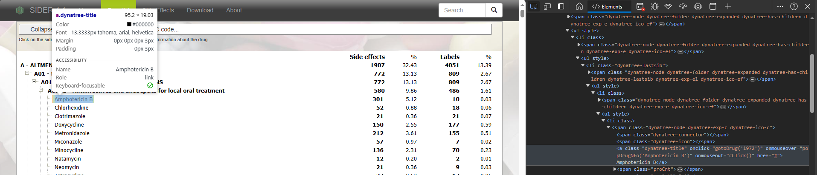
Not ready to scrape yet
building URLs for each drug

Slide 8

Scrapping
Now we are ready… yay!

Slide 9
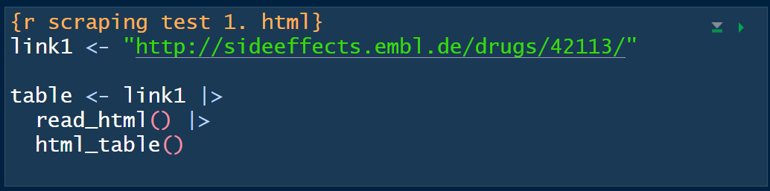
Getting tables
Then we get table 1 for side effects and table 2 for indications

Slide 10
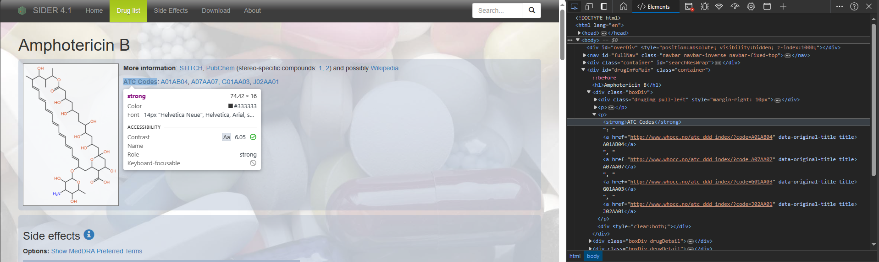
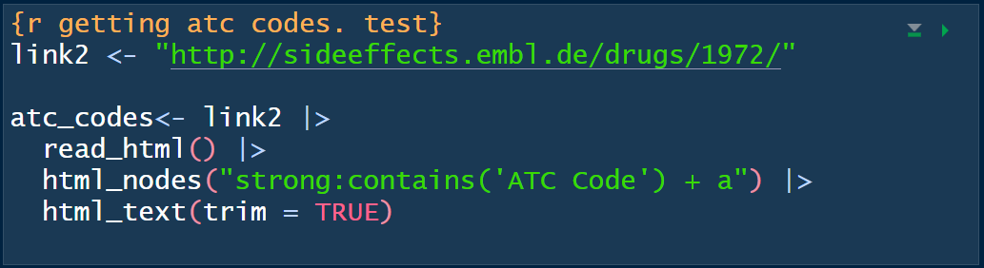
Getting ATC codes

Slide 11
Loop through it all…

Slide 12
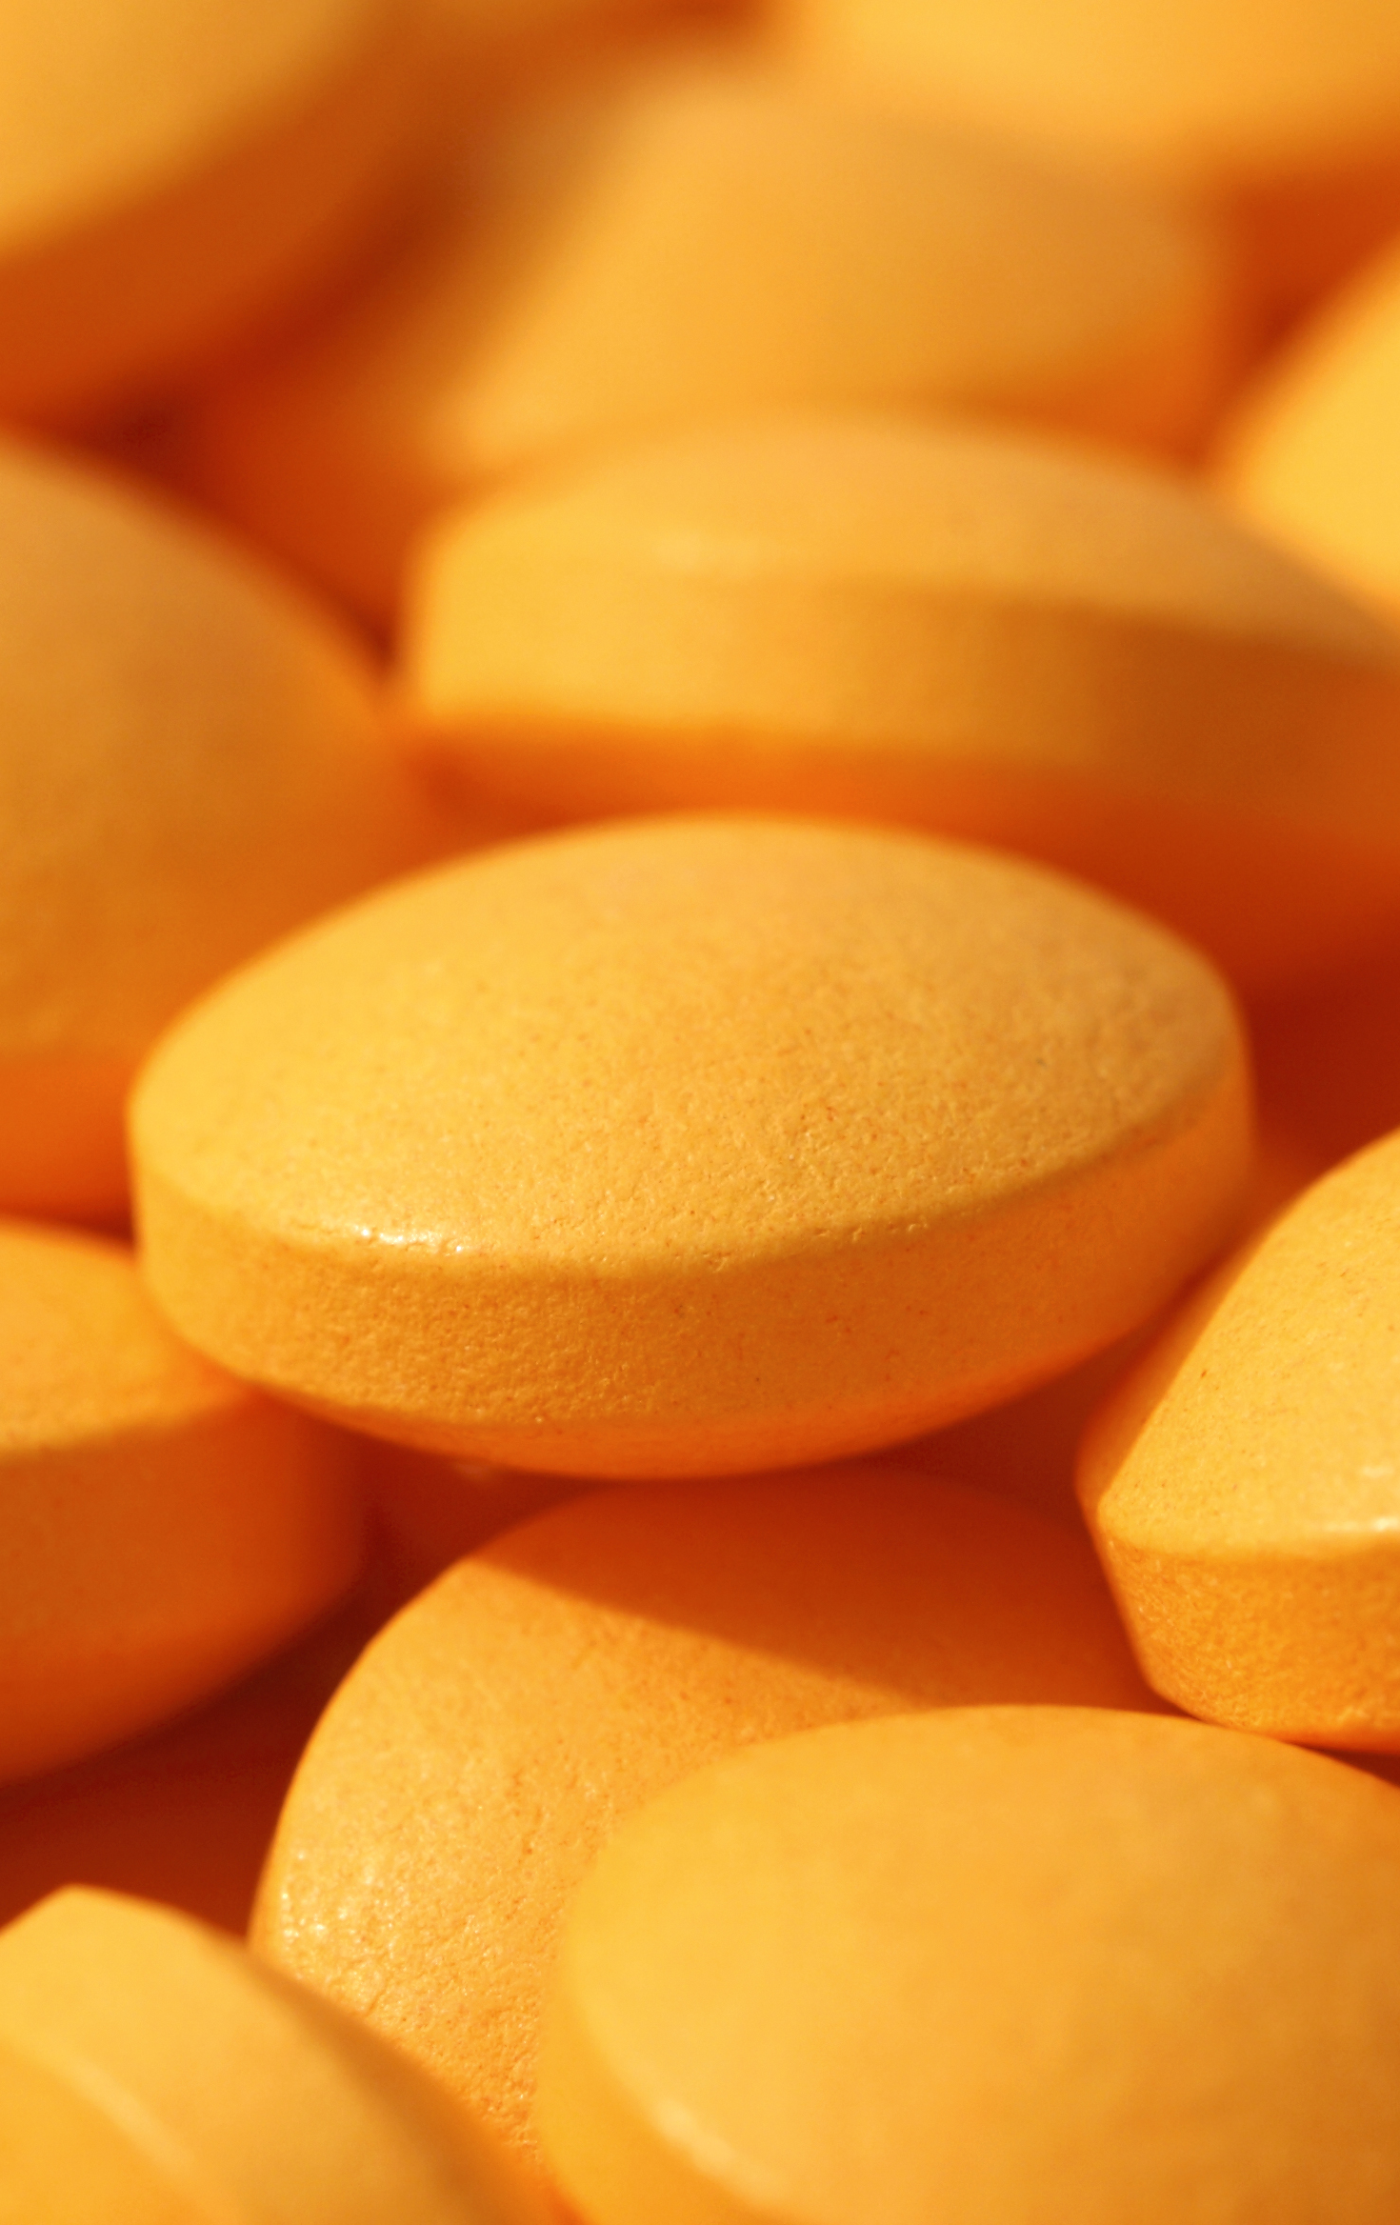
Using the data… Let me switch to R real quick. :D

Slide 13
Thank you

